Slide 1

Orion: Shortest Path Estimation for Large Social Graphs
Xiaohan Zhao, Alessandra Sala, Christo Wilson, Haitao Zheng and Ben Y. Zhao
Department of Computer Science, UC Santa Barbara, USA

Slide 2
Outline
Motivation
Designing Orion
Experimental Results
Using Orion in Graph Applications
Conclusion

Slide 3

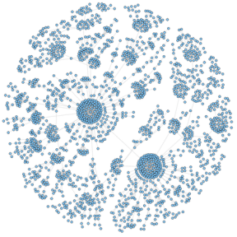

Super Large Social Graphs
500 million
Community
Social Influence
Potential Friends
……..
700 million

Slide 4


Maximizing Social Influence
Product advertisement in OSN
Bill Gates “Likes “ lotsinlife.com
Propagate information starting at a specific node
Start @ random node

Slide 5

Maximizing Social Influence
GOAL : find the most influential node in graph
Nodes with shorter average distance to rest of the graph
Influential node
Start @ influential node

Slide 6


Ranked Social Search
Search for specific friends in social network
Rank search result based on the social distances

Slide 7
Precondition
Social networks are characterized by graph properties like :
Power law degree distribution
Small World Clustering
Scale-free behaviors
Precondition for quantifying the characteristics :
Calculating node separation metrics
  Radius
  Diameter
  Average path length

Slide 8
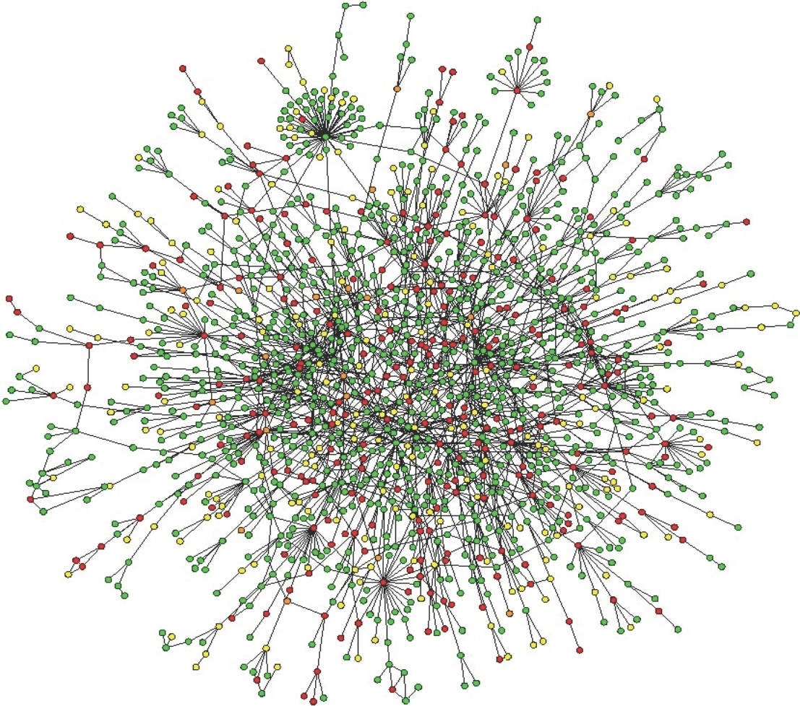

Node distance Computation Is hard
Why???

Slide 9
Node Distance Algorithms
For a graph with n nodes and m edges
Algorithm
Breadth-First Search (BFS)
Dijkstra
Floyd-Warshall

Slide 10
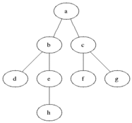
Breadth-Frist Search (BFS)

Slide 11
Node Distance Algorithms
For a graph with n nodes and m edges
Algorithm
Breadth-First Search (BFS)
Dijkstra
Floyd-Warshall
Complexities
O( | n | + | m| )
O( | m | + | n | log | n | )
O(|n|³)

Slide 12


Problem of Node Distance Algorithms
Node distance algorithms
Don’t scale !!
43
Million
Nodes
1 hour per BFS
1 Billion
Edges

Slide 13
A More Scalable Solution
Design a scalable system for large graphs
  Real-time queries are important
  Desired query time: O(1)
  Do preprocessing
How to achieve O(1) query time?
  Represent node distance in a graph as distance between two nodes in Euclidean Space
Map all graph nodes into Euclidean Space
  A Graph Coordinate System

Slide 14
Why Map to Euclidean Space
Coordinates are highly efficient in summarizing a large amount of distance information.
Consider an application with ‘K’ nodes
  In Euclidean space they can be communicated by ‘K’ set of coordinates of ‘D’ numbers each , So complexity is O(K.D)
  In a Grapy there will be K(K-1)/2 distance , Complexity O(K²)

Slide 15
Graph Coordinates Challenges
Triangle Inequality:
  d(a, b) + d(a, c) < d(b, c) , a.b.c are three nodes
  Let d(.) be the shortest path between each nodes
Cost of Measurements :
  Computing distance from a to b using BFS effectively computes the shortest path
  between a to all other nodes in the graph
  Latency measurement is less expensive than calculating the shortest path
Error Sensitivity :
  Graph coordinate systems face a challenge of high error sensitivity
  Latency between Internet nodes can vary between few to hundreds of milliseconds.
  Node distance values across different paths in a graph are significantly more clustered
  Across a small number of possible values

Slide 16
Outline
Motivation
Designing Orion
Experimental Results
Using Orion in Graph Applications
Conclusion

Slide 17
Design Goals of Orion
Scalability (Preprocessing time):
  The computational cost of the calibration phase must scale linearly with graph size, i.e. O(n).
  Minimize the number of BFS operations
Accuracy:
  While individual node distance predictions might incur reasonable errors, predictions should approximate ground truth at the large scale.
Fast convergence:
  Impact of individual node calibrations should be localized, i.e. should not oscillations

Slide 18
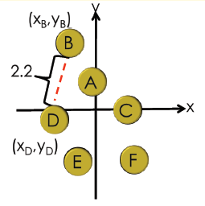
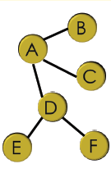
Orion
A Graph Coordinate System
  Embedding: “Capture” node distances using Euclidean positions
  Estimate node distances using coordinates in constant time

Slide 19
Goal
Accurately translate pairwise hop-count distances in the graph into Euclidean distances in the coordinate space.
HOW ??
Landmark based Schemes
WHY ??

Slide 20

Approaches for Embedding
Physical spring system
Each node needs to do BFS computation
  Huge number of BFS
Multiple Iterations
Slow Convergence
G
A
E
E
E
E
F
F
C
C
A
D
D
B
G
D
B
B
B

Slide 21
Landmark based Schemes
If we want to find the shortest path we need to establish ground
truth on the graph
Using landmark based Schemes the total number of BFS search can
be reduced
The positions of incoming nodes depend only on the landmark nodes

Slide 22
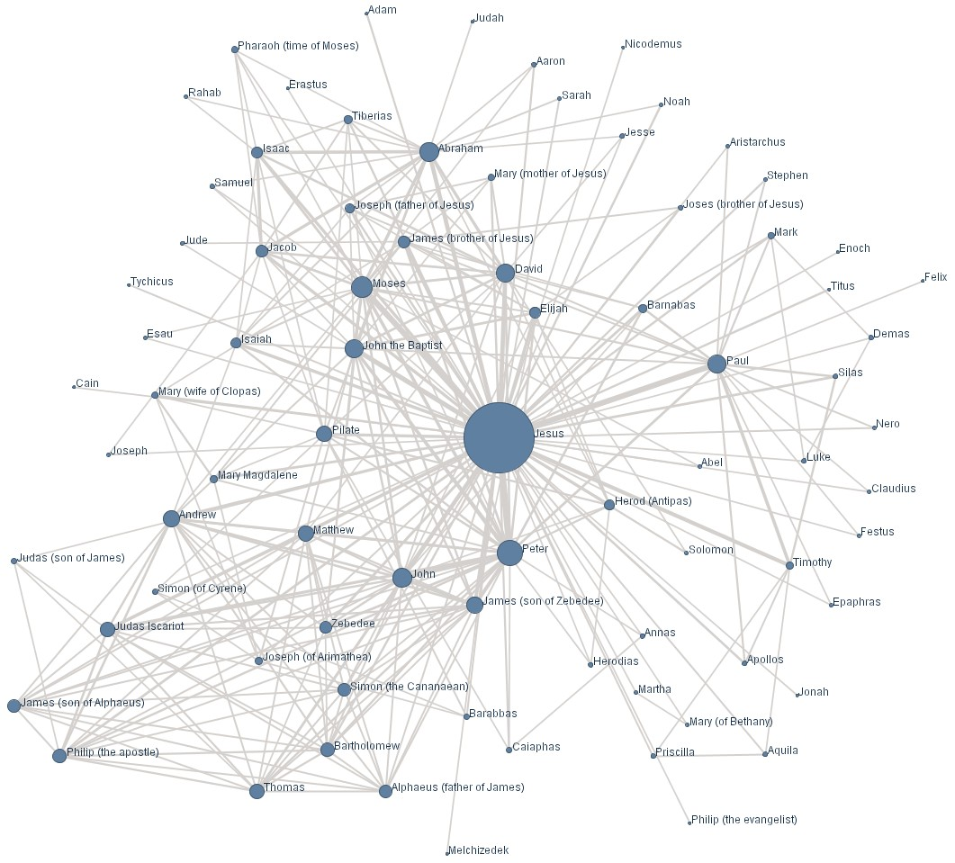
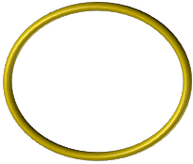
How to select Landmarks?
Random: Landmarks are chosen uniformly at random from all nodes
High-degree: highest degree nodes as landmarks
  “Backbone” of social graph
Landmark separation
  Highest degree nodes often
  connected to each other
  Need to avoid clusters of
  landmarks

Slide 23
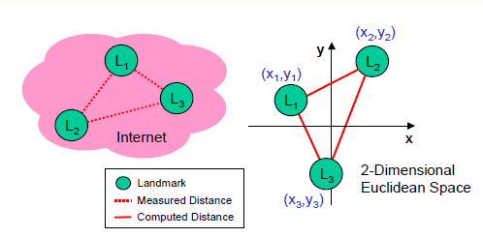


How to Position Landmarks ?
The error optimization is done using the Simplex Downhill algorithm

Slide 24
How to Position Landmarks ?
Naïve solution: Global Simplex
Downhill
  O(k²D) for k landmarks in D-dimension
  space
  However, k can be large for large
  graphs
Incremental approach
  Divide k landmarks into two groups
    Small initial group L_{k} (16)
  Two step computation
    Initial group: global simplex downhill
    Remaining landmarks added one by one
      Use initial landmarks to calibrate distance

Slide 25
How is the Shortest path Calculated ??
Total No of BFS operations is reduced to k
Each BFS calculates the shortest path distance from a landmark to all nodes

Slide 26
Outline
Motivation
Designing Orion
Experimental Results
Using Orion in Graph Applications
Conclusion

Slide 27
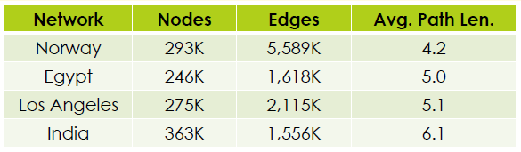
Experimental Setup
Datasets
  Four datasets from Facebook regional networks
Evaluation Metrics
  Relative Error
  Average Relative Error
  Computational Time
  Dimensionality of Coordinates
  Computation Time

Slide 28
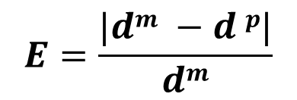
Relative Error
  Relative Error:
  d^{m} : actual distance
  d^{p}: estimated distance computed by Orion

Slide 29
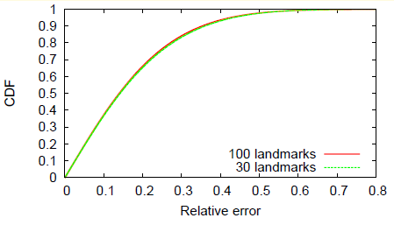
Cardinality of Landmark Sets
70% have relative error less than 0.2
90% have relative error less than 0.4

Slide 30
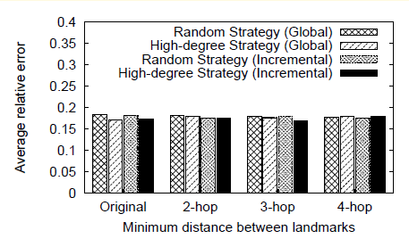
Average Relative Error
Evaluation is performed by selecting 1000 random nodes
Pairwise distance is computed between them for total of approximately 500K
Distances

Slide 31
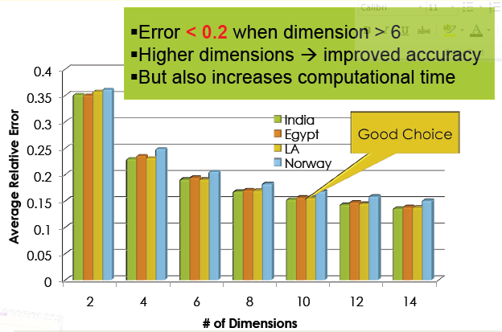
Dimensionality of Coordinates

Slide 32
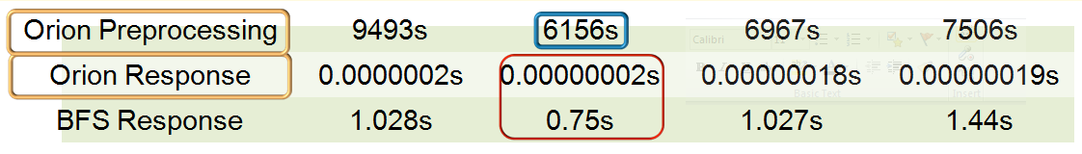
Computation Time
Orion Preprocessing: to compute coordinates for all nodes
One-time cost
  2 hours for 300K node graph on 1 cheap commodity server
  Time scales linearly with graph size
    Easily parallelized across clusters
Average time per node-distance query
  Orion is 7 orders of magnitude faster than BFS

Slide 33
Outline
Motivation
Designing Orion
Experimental Results
Using Orion in Graph Applications
Conclusion

Slide 34
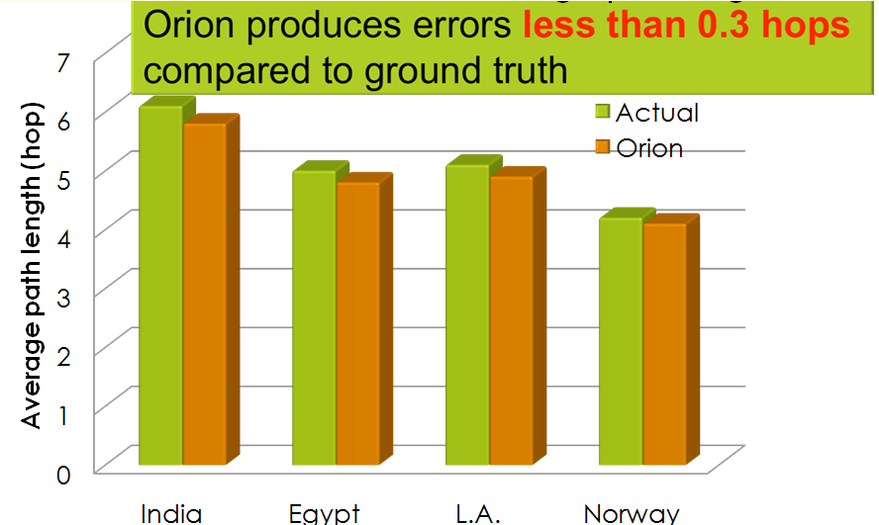
Application I: Node Separation Metrics
Node separation metrics
  Common tool to analyze graphs Include radius, diameter and average path length
A single node BFS takes more than 6 days for computation for LA with 275K nodes
Orion takes 2 hours

Slide 35
Application II: Node Centrality
Centrality is defined as the average shortest path length from a node a to every other nodes in the graph.
The smaller the average path length for a node is, the higher its centrality is.
Importance :
Information dissemination

Slide 36
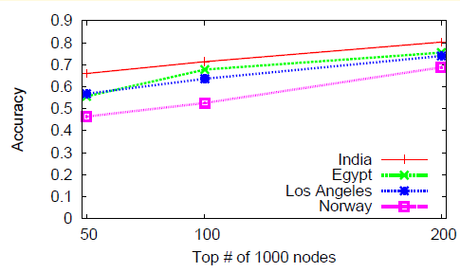
Accuracy of top k high centrality nodes
1000 random nodes are selected from the graph
The overlap between Orion and BFS results increases with k.
centrality results for India are more accuracy rate because it has the longest average path lengths
Orion giving correct estimates more than 50% of the time

Slide 37
Outline
Motivation
Designing Orion
Experimental Results
Using Orion in Graph Applications
Conclusion

Slide 38
Conclusion
We propose Orion, a scalable graph coordinate
system for node distance computation
Time complexity is low
  Preprocessing: 2 hours for a 300K node graph
    Can be parallelized across machine clusters
  Query Response: 0.2μs to estimate node distances for
  per query
Orion can accurately support node-distance based
applications

Slide 39
Future / Ongoing Work
Dynamics in social graphs
Investigate the impact of graph dynamics on node distances
Use heuristics to incrementally update graph embedding's at run time
Weighed graphs
Examine the use of graph coordinate systems on applications on weighted
graphs

Slide 40
Remarks
Orion is designed for static graphs
Drawbacks of network coordinates are ignored
The problem isn’t discussed in detail

Slide 41
References
[1] Xiaohan Zhao, Alessandra Sala, Christo Wilson, Haitao Zheng and Ben Y. Zhao, Orion:
Shortest Path Estimation for Large Social Graphs, WSON 2010
[2] NG, T. S. E., AND ZHANG, H. Predicting internet network distance
with coordinates-based approaches. In Proc. of INFOCOM (New York, NY, June 2002)
[3] NELDER, J. A., AND MEAD, R. A simplex method for function minimization. The Computer Journal 7,
4 (Jan. 1965), 308–313
[4] Wikikepedia , www.wikipedia.org

Slide 42
Additional Slides

Slide 43
DownHill Simplex Algorithm
1. Order according to the values at the vertices:
2. Calculate x_{o}, the center of gravity of all points except x_{n + 1}.
3. Reflection
Compute reflected point
If the reflected point is better than the second worst, but not
better than the best, i.e.: ,
then obtain a new simplex by replacing the worst point x_{n + 1} with
the reflected point x_{r} and go to step 1.
4. Expansion
If the reflected point is the best point so far,
then compute the expanded point
If the expanded point is better than the reflected point,
then obtain a new simplex by replacing the worst point x_{n + 1} with the expanded point x_{e},
and go to step 1.
Else obtain a new simplex by replacing the worst point x_{n + 1} with the reflected point x_{r},
and go to step 1.
Else (i.e. reflected point is not better than second worst) continue at step 5.

Slide 44
DownHill Simplex Algorithm
5. Contraction
    Here, it is certain that
    Compute contracted point
      If the contracted point is better than the worst point, i.e.
      then obtain a new simplex by replacing the worst point x_{n + 1} with the contracted point x_{c},
      and go to step 1.
    Else go to step 6.
6. Reduction
    For all but the best point, replace the point with
    . go to step 1.

Slide 45


